Slide 1
GrievEase: Making grievance submission easy while mapping government benefits.
SHREE HARSHINI S 220701269
SRI KIRUPA P 220701286
SRIRAMAN K 220701288

Slide 2
01
PROBLEM Statement
How might you create a user-friendly software solution to map government schemes to beneficiaries based on their socio-economic background.Ensure real-time access and a citizen-centric design for efficient grievance redressal.

Slide 3
02
NOVELTY
🧠 XGBoost + FairLearn + AIF360 → Accurate, fair & bias-aware scheme recommendations tailored to each citizen.
📊 Match Score + Real Impact Feedback → Shows how many users liked or benefitted from the scheme — via 👍 Like/👎 Dislike buttons for informed decisions.
🎯 Grievance Redressal with Admin Support → Users can raise issues, and a dedicated admin panel ensures resolution — not just recommendation, but action.
✨ Why it Matters? Most platforms stop at listing schemes. We go beyond, combining AI, fairness, feedback, and support into one citizen-first system.

Slide 4
03 Motivation
📊 Market Gap — Why ‘GrievEase’ Matters
🚨 The Reality Today:
🔍 58% of eligible citizens are unaware of the schemes available to them. (Source: NITI Aayog Survey, 2021)
💬 70% of scheme-related complaints go unresolved due to poor follow-up. (Source: Ministry of Rural Development Grievance Stats)
🌐 Government portals are: Not personalized ❌ Lack feedback or ratings ❌ No built-in grievance escalation ❌

Slide 5
04 Competitive Comparison
Features
UMANG/ MyScheme
GrievEase
🎯 Personalized Scheme Suggestions
❌ Limited / Manual search-based
✅ AI-based using XGBoost + FairLearn
📊 Fairness & Bias Handling
❌ Not integrated
✅ Uses AIF 360 for unbiased recommendations
💬 Feedback Mechanism
❌ Absent
✅ Like/Dislike with benefit stats shown
🧠 Match Score Prediction
❌ Not available
✅ Smart Match Score for transparency

Slide 6
05 Target Audience
01
03
02
04
“Schemes aren’t one-size-fits-all — so neither is our solution!”
👨‍🌾 Meet Ramu the Farmer
🎓 Priya the Student
Wants to know about crop insurance and fertilizer subsidies.
GrievEase shows only the schemes he’s eligible for. 💡 Bonus: He can “👍” a scheme that helped his village buddy.
Searching for scholarships for girls in STEM.
GrievEase matches her profile and ranks the best-fit schemes. 💬 She checks reviews from other students before applying.
Lakshmi Paati (Senior Citizen)
🧑🏽‍🤝‍🧑🏽 NGOs & Village Volunteers
Confused with all the pension schemes online.
GrievEase helps her apply in 3 taps. 🛠️ And yes—she raises a complaint, and the admin actually responds.
Use GrievEase to assist multiple citizens using one device.
Quick, accessible, and multi-profile support — saving time and effort.

Slide 7
06 Tech Stack + ML Overview
🌐Frontend:
- HTML, CSS, JavaScript
- Future: React.js / Next.js
🔧 Backend + Integration:
- PHP (Current), Node.js (Future)
- Manages API and data flow
💾Database:
- MySQL for user, scheme & grievance storage
🧠Machine Learning:
- XGBoost: Scheme matching
- Fairlearn: Grievance fairness
🎯Purpose:
- AI-powered, citizen-centric welfare deliver

Slide 8
07 How GrievEase Works ?
Meet Arjun, a Farmer
Fills Profile Form
ML Magic Begins!
🗣️ Arjun says: “I want to know about subsidy schemes for fertilizers.”
🎙️ Input accepted using 💬 Type form
🧾 Name, age, occupation, location, income level
🔐 Data is validated using JavaScript
📤 Submitted to backend via PHP
🚀 XGBoost → Predicts best-fit schemes
⚖️ FairLearn → Ensures no discrimination
🛡️ AIF360 → Audits bias + fairness
📈 Outputs: Match Score + Personalized Scheme List
Smart UI Displays Results
User Reacts
Admin Dashboard
📱 User sees:
✔️ Top Matched Schemes
👍 How many liked it
📊 Match Score %
👍 Likes the scheme that helped him
❌ Reports an issue with another
📝 Feedback gets stored in MySQL DB
👨‍💼 Complaint assigned to officer
🔁 Status updates tracked
✅ Grievance resolved = citizen happy
🎉 Result: “Arjun applied for a scheme he didn’t even know existed and got real help, thanks to GrievEase!”

Slide 9
✨ Key Features:
Icon-Based Navigation – Enables quick, intuitive movement throughout the platform
3-Click Scheme Finder – Access the right government scheme in just three steps 🎯 Design Focus:
Simplicity – Clean layout for effortless use
Accessibility – Usable by people of all abilities
Inclusivity – Designed for all languages, literacy levels & devices
08 UI/UX Design Highlights

Slide 10
09 Impact 🚀 + Marketing Strategy 🎯
🌟 The Impact We Aim to Create
🧠 Smarter Awareness → No more guessing or scrolling — people instantly know which schemes fit them best!
📈 Boost in Scheme Utilization → Citizens are 4x more likely to apply for schemes when it’s personalized, local, and fair.
💬 Engaged & Empowered Users → With like/dislike feedback and admin support, people feel heard. → Transparent system = trust in government digital efforts.
🛡️ Fair Access for All → Thanks to FairLearn + AIF360, biases are reduced. → Rural, senior, and low-income groups don’t get left behind.
🗂️ Real-time Data Insights for Government → Admins see what’s working, where issues arise, and which regions need focus — live.
🎯 Marketing Strategy – Not Just Promotion, It’s Empowerment!
🤝 Partner with NGOs & Local Seva Centers → They know the pulse of the people — GrievEase becomes their digital ally.
📍 Rural Kiosk Demo Program → Set up digital awareness booths in weekly markets & panchayats → Offer live demo, feedback collection, and scheme matching
👥 Campus & Volunteer Program → Let tech students & volunteers act as “GrievEase Ambassadors” in their towns → Combine social impact + tech evangelism
🎙️ Radio + WhatsApp Campaign → Local FM & WhatsApp broadcasts: “Send ‘Hi’ to get your best government scheme!”

Slide 11
10 Conclusion
This project presents a smart, user-friendly platform that bridges the gap between citizens and government welfare schemes by mapping beneficiaries to relevant programs based on their socio-economic background. Through real-time access, AI-powered recommendations using XGBoost, and a transparent grievance redressal system enhanced by Fairlearn and AIF360, the solution ensures accessibility, fairness, and inclusivity. By focusing on citizen-centric design and automation, the system transforms traditional welfare access into an efficient, data-driven public service experience.
Github
https://github.com/ShriKirupa/220701286-GE19612-PRIEE
https://github.com/Shreeharshini-harsh/priee-269-286-288
https://github.com/Sriraman22/220701288-GE19612-PRIEE
https://india-citizen-connect.lovable.app/

Slide 12
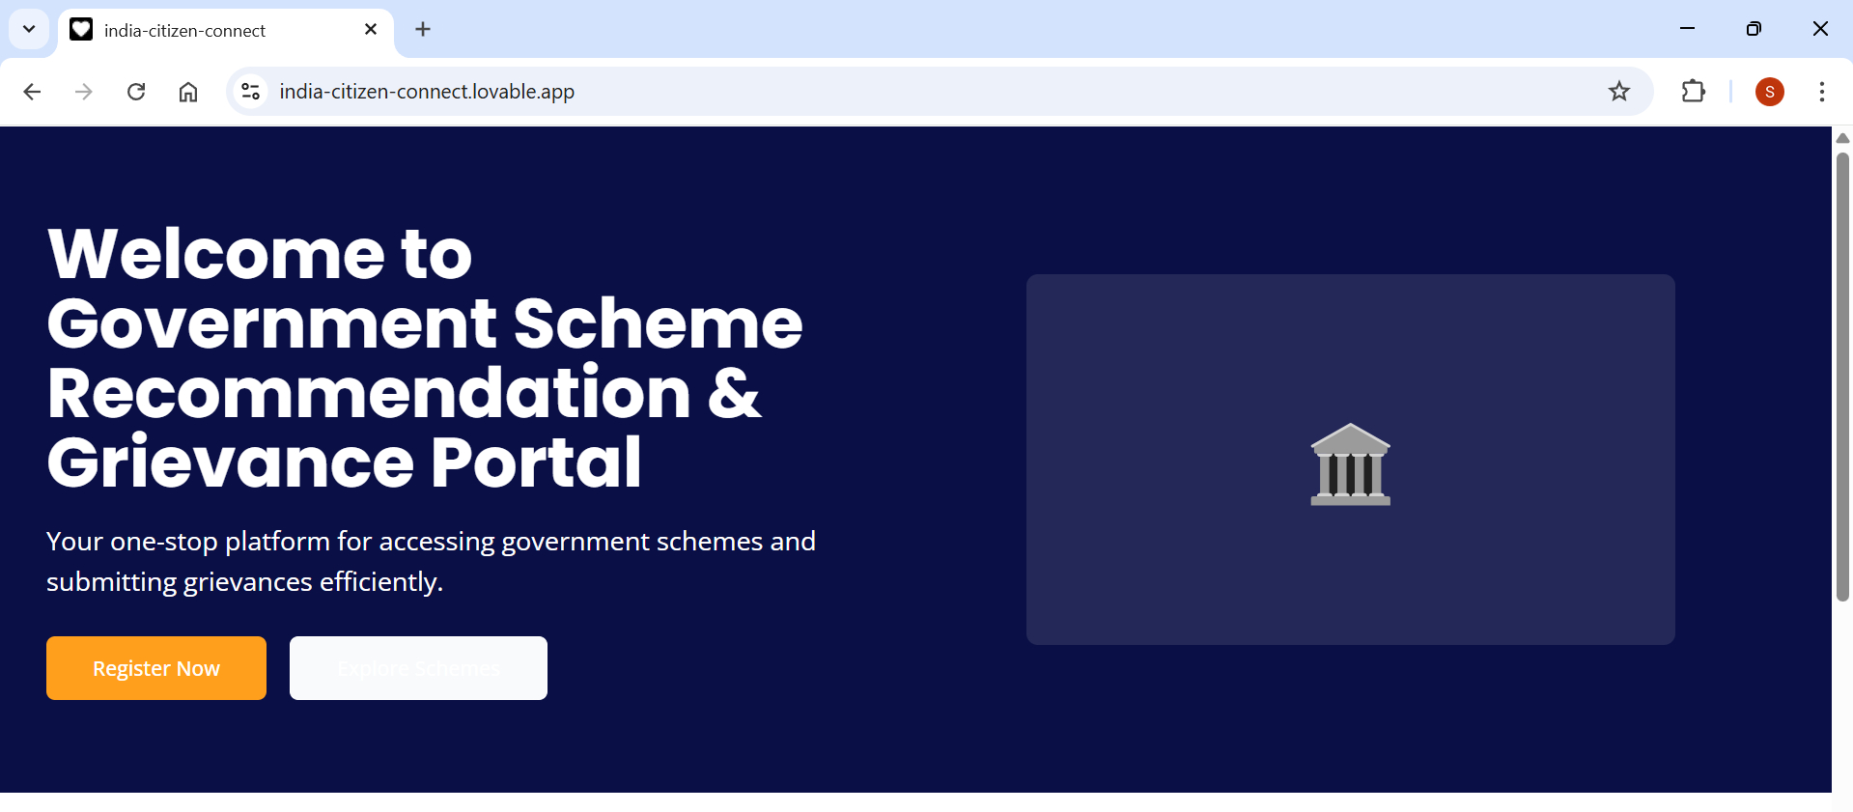
Mockups

Slide 13
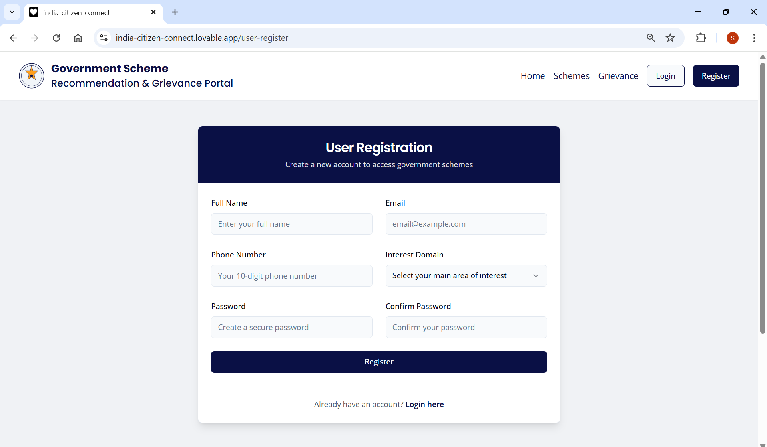
Mockups

